Slide 1



Slide 2


高三年级英语学科
25-26学年海淀期末阅读表达评标
授课教师： 郑灿 学校：北京大学附属中学
指导教师： 栗瑞莲 刘璐霏 学校：海淀区教师进修学校

Slide 3

Acknowledgements
栗瑞莲、刘璐霏老师的命题全程悉心指导，
阅表命题组的同心协力智慧投入,
阅表定标组的辛勤付出！
阅表命题组
（按姓氏拼音顺序）
阅表定标组
（按姓氏拼音顺序）
廖春华 | 海淀教师进修实验
李晓立 | 北师大三附
刘丹 | 首师大附
刘珏 | 清华附中
刘璇 | 理工附中
马悦 | 人大附中
王曌君茹 | 101中学
徐静 | 首师大附
张垚 | 人大附中分校
郑灿 | 北大附中
刘桂章 | 清华附中
廖春华 | 海淀教师进修实验
房立新 李琳琳 | 十一学校 北大附中
尹然 | 清华附中
杜泉滢 | 101中学
王曌君茹 | 101中学
郑 灿 | 北大附中

Slide 4

1
第一部分 选文意图
目 录
2
第二部分 试题解读
CONTENTS
3
第三部分 评分标准
4
第四部分 教学建议

Slide 5
01
选文意图

Slide 6
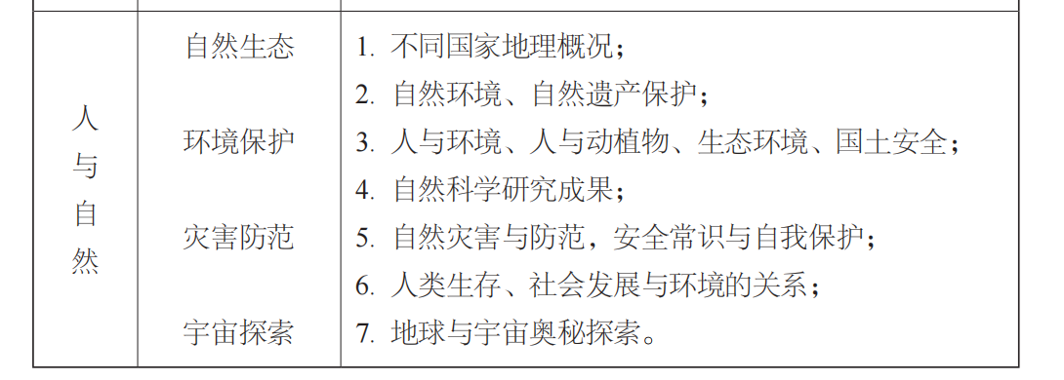
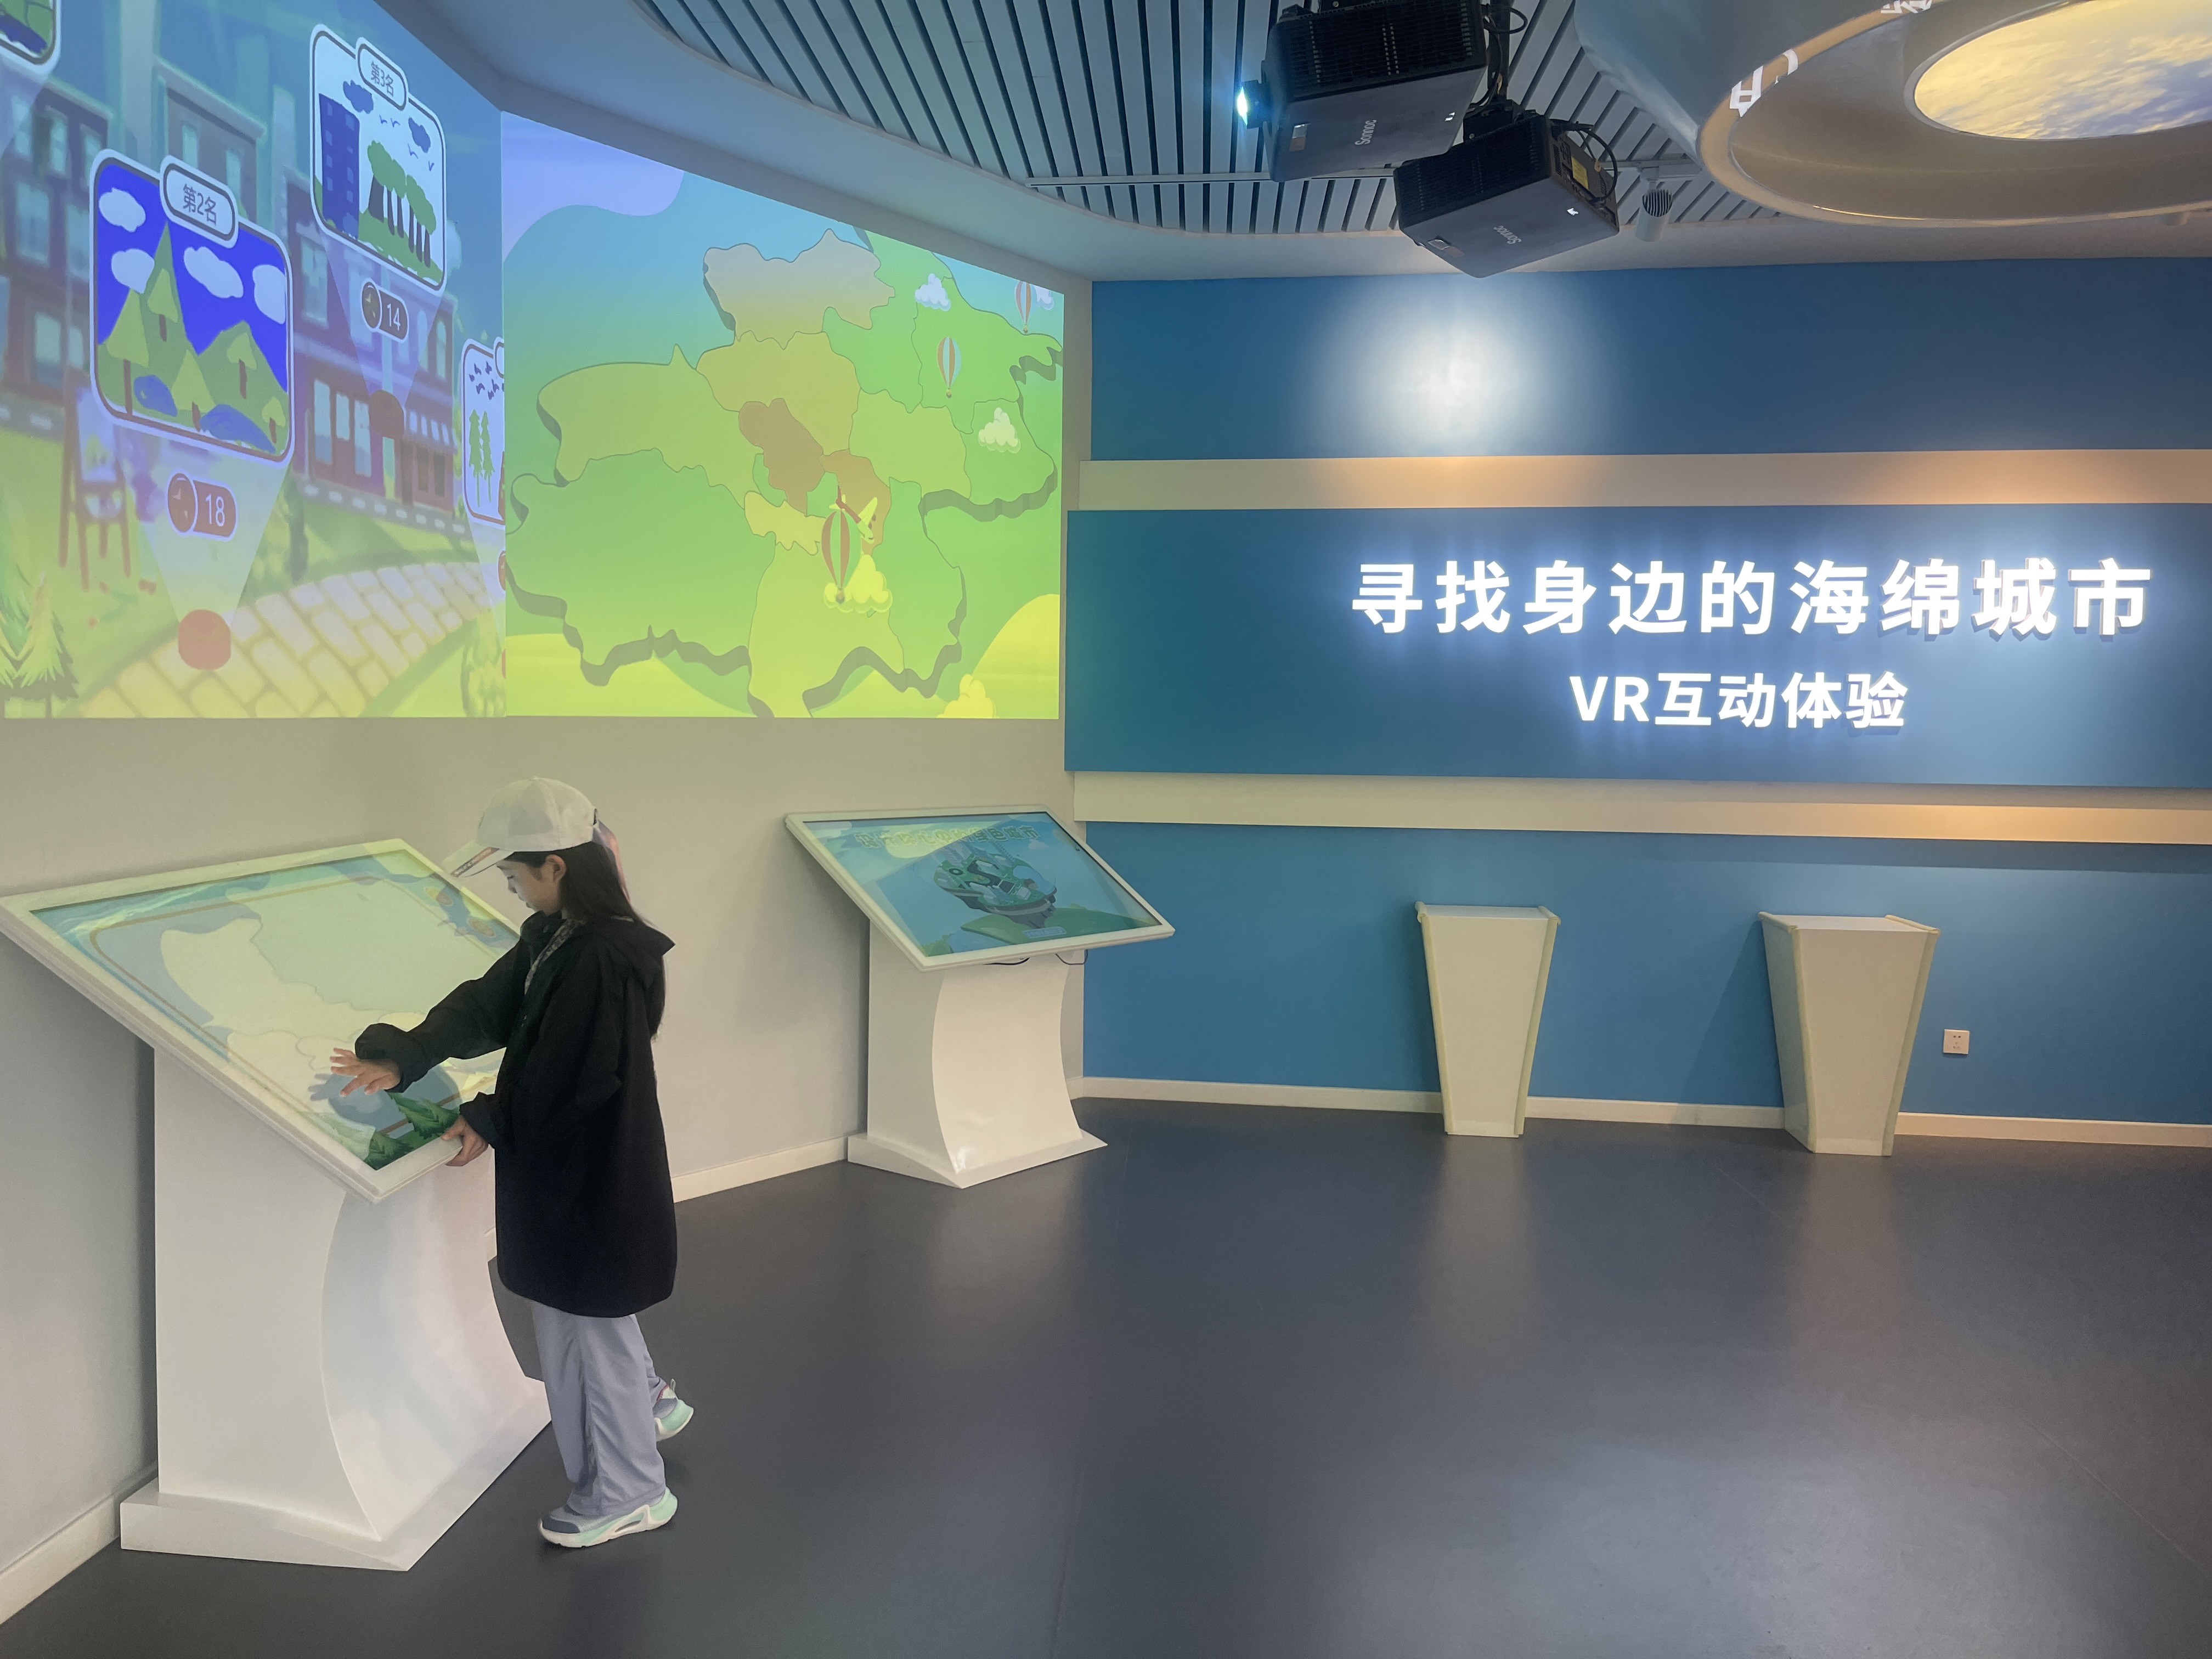
主题选定
2017年版2025年修订普通高中英语课标

Slide 7
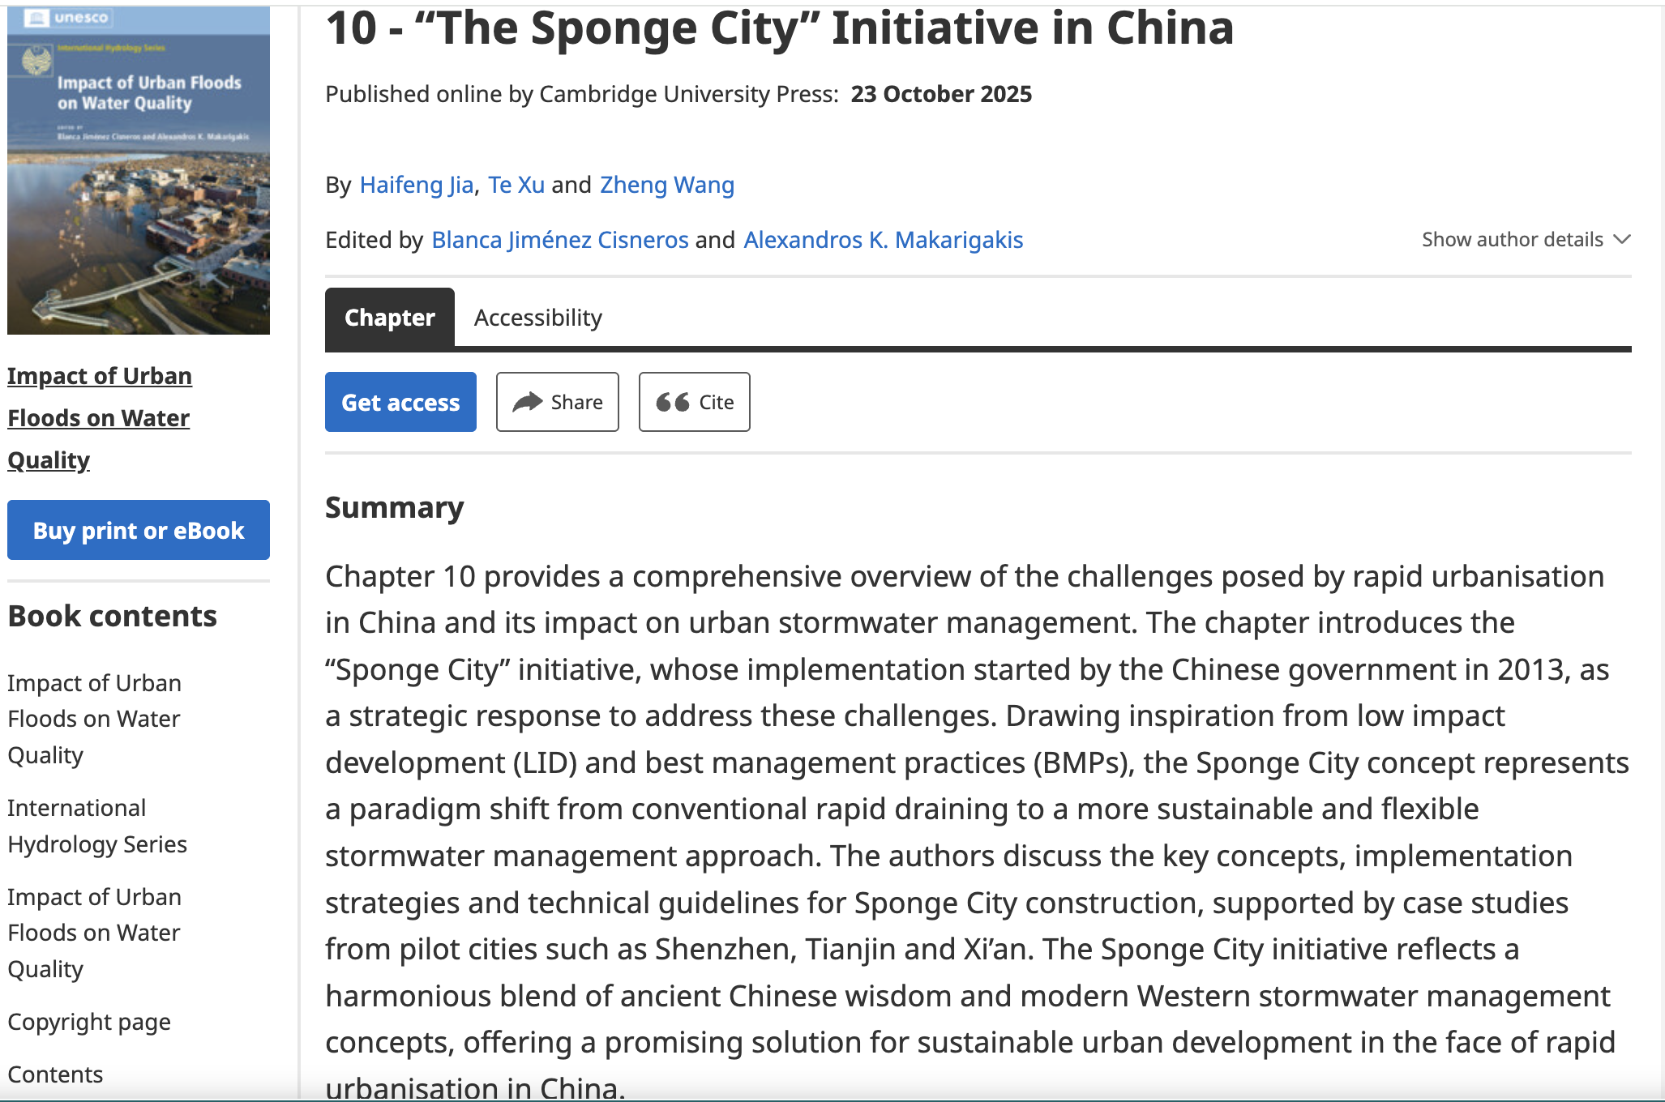
主题选定

Slide 8
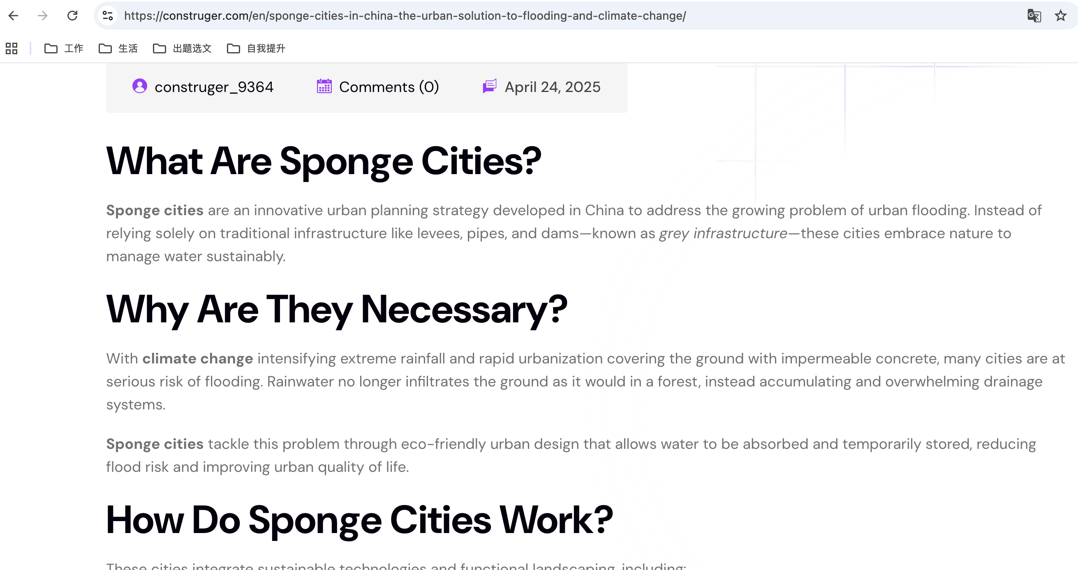
文章主体

Slide 9
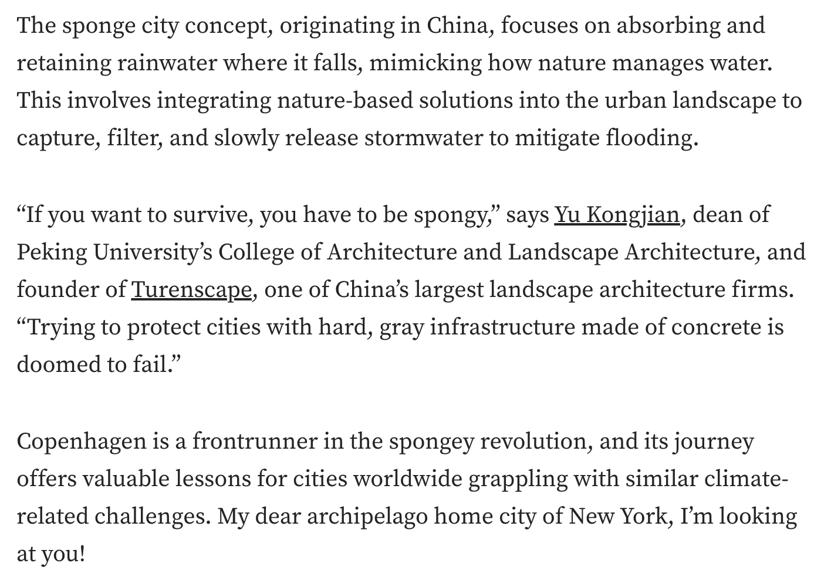
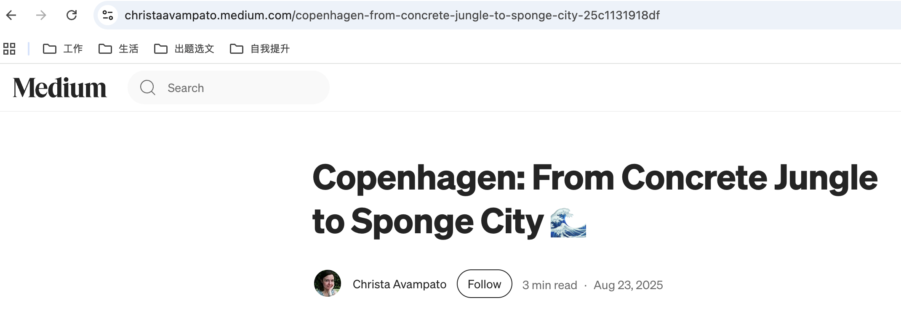
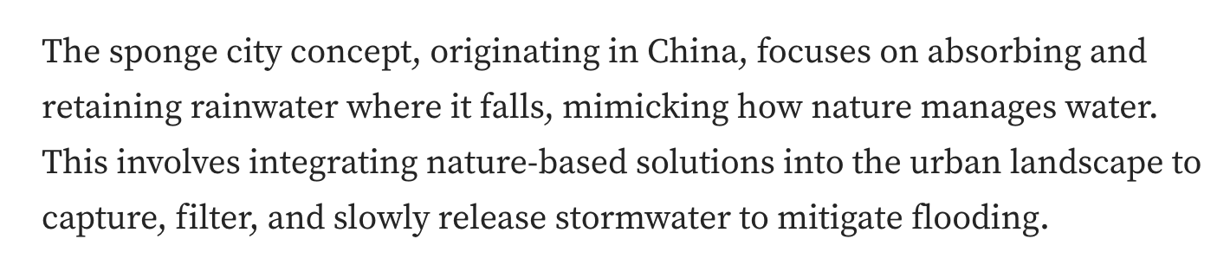
个别例子

Slide 10
02
试题解读

Slide 11
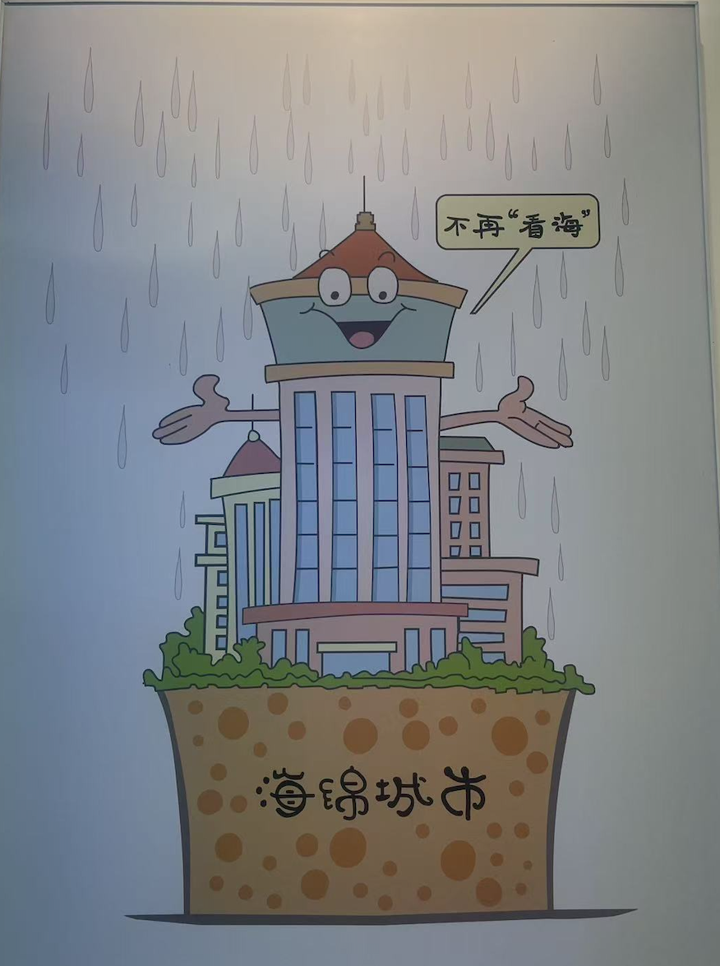

文章类型 | 说明文（318 words）
文本大意 | 本文介绍了 “海绵城市” 这一城市规划理念的提出背景、运作方式、多元益处及广泛认可。
文章主旨 | 强调 “海绵城市” 是应对环境挑战，建设更加绿色、更具韧性城市的智慧方案，也是对未来世代福祉的投资。
主题语境 | 人与自然（环境保护与灾害防范）

Slide 12
¹ With climate change and rapid urbanization, many cities are at serious risk of flooding. To tackle this problem, Chinese researchers first proposed the “sponge city” concept — an urban planning strategy that uses nature to sustainably manage water, reducing reliance on concrete pipes and dams.
² How do sponge cities work? These cities combine sustainable technologies and functional landscaping, including pavements that allow water to go down into the ground; urban parks and green spaces that act as places to hold water during heavy rain and as recreational zones during dry periods; urban wetlands that naturally filter water and promote biodiversity; waterways and channels that are linked together to efficiently transport and store water. All these elements transform the urban landscape into a “sponge” capable of absorbing and releasing water according to climate conditions.
³ The benefits of the sponge city approach are diverse. Beyond its primary function of reducing flood risk and easing pressure on drainage systems, this strategy significantly enhances urban livability. How is this possible? It creates extensive green zones that expand healthy public spaces for recreation, improve air quality, and support increased urban biodiversity.
⁴ This urban planning model has achieved widespread international recognition. In China, it was officially adopted as a nationwide policy in 2014, with cities like Wuhan and Beijing leading implementation efforts. Following devastating floods of a 2011 storm, the city of Copenhagen launched its own sponge city transformation plan. Fundamental to the strategy are green infrastructure (基础设施) elements, such as redesigned parks that serve as retention basins during heavy rains, along with blue infrastructure like the city’s extensive canal network to channel and store excess water.
⁵ The sponge city strategy signals a smarter way forward in city-building: greener, more resilient, and matched to today’s environmental challenges. At its core, it’s more than a fix for climate chaos — it’s an investment in the well-being of future generations.
Para. 1: Introduction
（Background + Concept）
Para. 2: Mechanism
Para. 3: Benefits
Para. 4: Implementation
Para. 5: Significance

Slide 13
命题原则
由浅入深，按照文章行文逻辑进行设问，引导学生完成对整个语篇的理解。在最后一个问题中，引导学生能够基于语篇并联系自身实际，有效地用英语输出。
40. According to the passage, what does the “sponge city” concept refer to?
41.What are the benefits of the sponge city approach?
42. Please decide which part is false in the following statement, then underline it and explain why.
The sponge city transformation plan of Copenhagen involves building new parks and making use of its canal network.
43. In addition to what is mentioned in the passage, what other way(s) would you propose to make your city more livable? (In about 40 words)
学习理解
学习理解
分析判断
创新迁移

Slide 14
03
评分标准

Slide 15
阅读表达评分重点说明
1. 每人每题最少判450份, 阅卷中遇到特殊问题，直接提交问题卷即可
2. 40、41、42划线零误差（请格外关注语言错误，如拼写、语法）；42解释，0.5分误差；Q43，1分误差
3. 先判Q43再判其他题

Slide 16
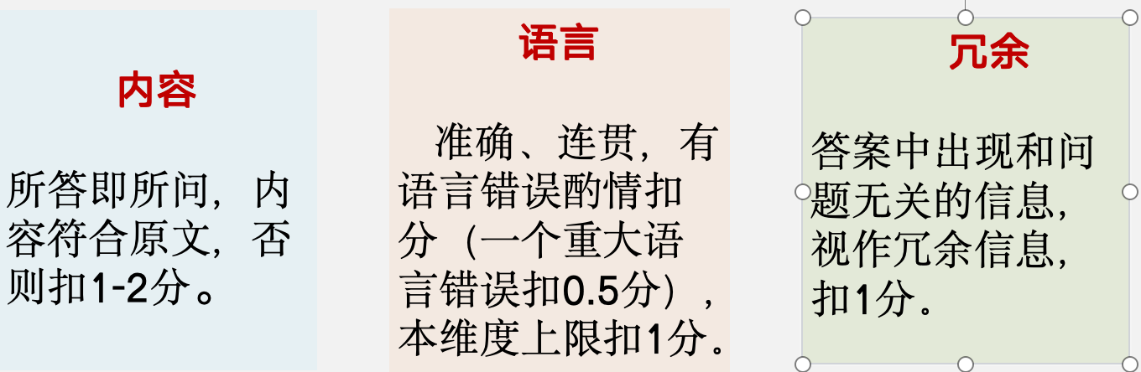
40-42题总体标准（各方面可叠加）
重大语言错误：与动词（如时态、语态、三单）和关键实词相关

Slide 17
阅读表达40题参考答案

Slide 18
40. According to the passage, what does the “sponge city” concept refer to? (2分)
It refers to an urban planning strategy that uses nature to sustainably manage water, reducing reliance on concrete pipes and dams.
(Para. 1) With climate change and rapid urbanization, many cities are at the serious risk of flooding. To tackle this problem, Chinese researchers first proposed the “sponge city” concept — an urban planning strategy that uses nature to sustainably manage water, reducing reliance on concrete pipes and dams.

Slide 19

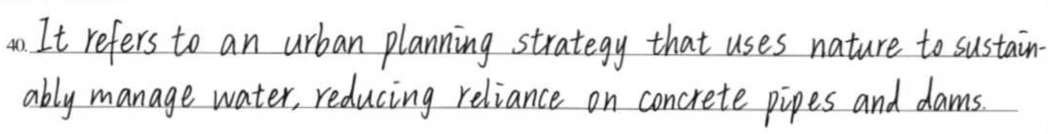
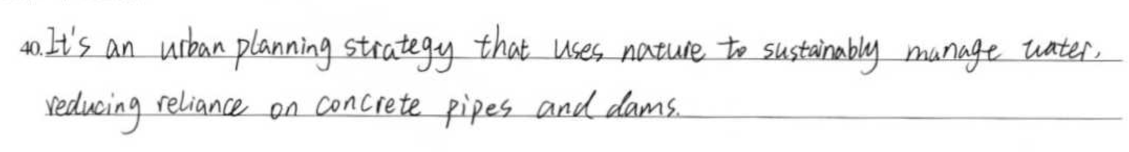
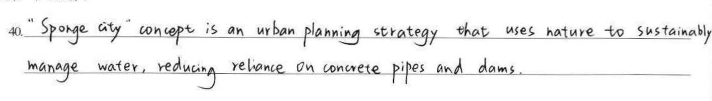
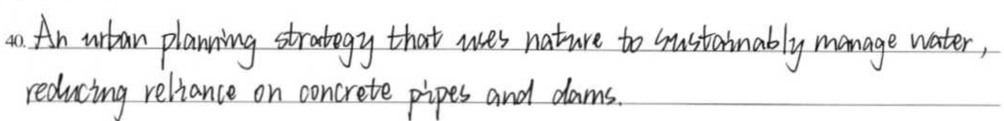

Slide 20
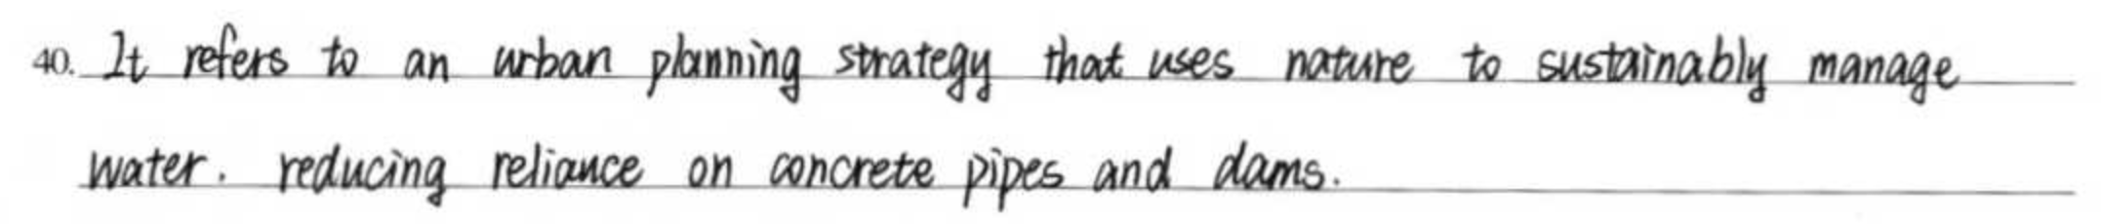
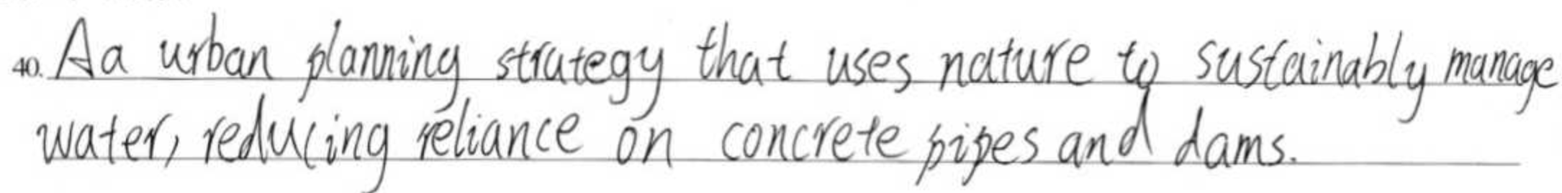

Slide 21
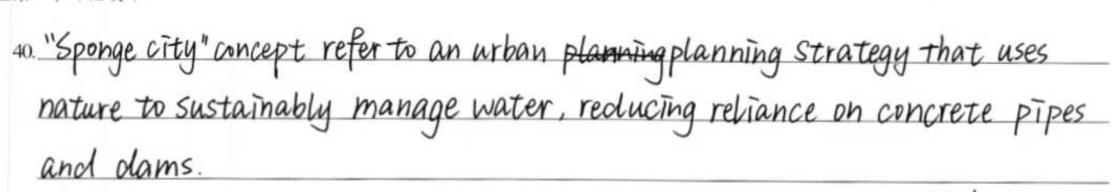
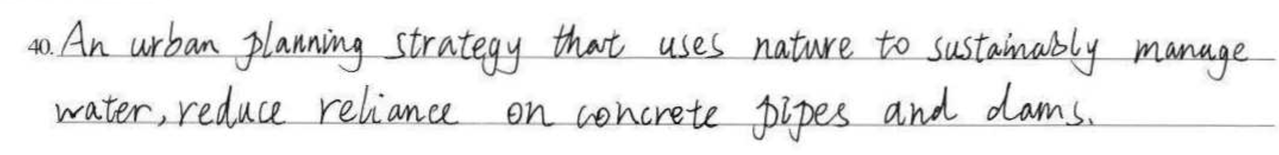
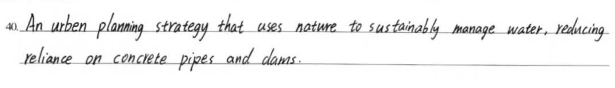
扣0.5: 主谓不一致
扣0.5分：动词形式有错
扣0.5: 回答不完整
扣0.5分：实词拼写有误
扣0.5分：信息不完整

Slide 22
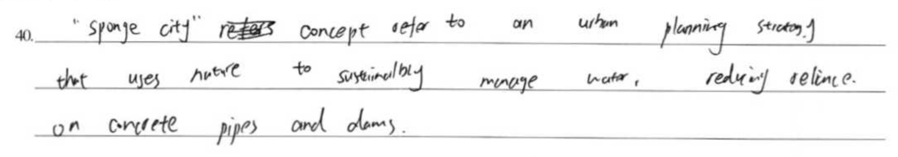
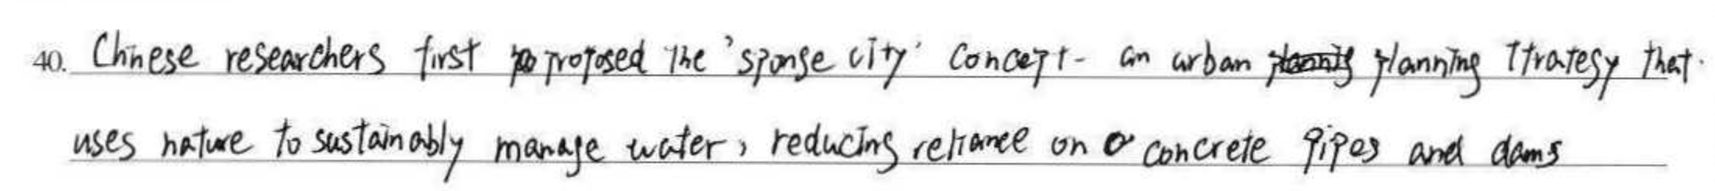
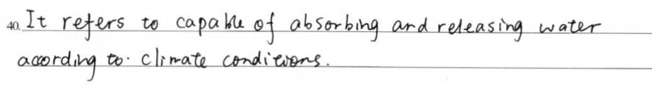
扣1: 多处语言错误，累计最高减1分
扣1: 主语和谓语动词都不对，答非所问/冗余
扣2分：所答非所问

Slide 23
40题阅卷划重点：
请老师们严格查看语言错误，重点关注：
1. 内容：所答即所问+完整（后半部分信息缺失）
2. 语言：动词（如时态、语态、三单）+ 关键实词（拼写）（累计最高扣1分）
3. 冗余：是否有冗余信息（扣1分）
ps. 冗余和语言错误可以累加

Slide 24
阅读表达41题参考答案

Slide 25

41. What are the benefits of the sponge city approach?
It reduces flood risk, eases pressure on drainage systems, and also enhances urban livability.
(Para. 3) The benefits of the sponge city approach are diverse. Beyond its primary function of reducing flood risk and easing pressure on drainage systems, this strategy significantly enhances urban livability. How is this possible? It creates extensive green zones that expand healthy public spaces for recreation, improve air quality, and support increased urban biodiversity.

Slide 26
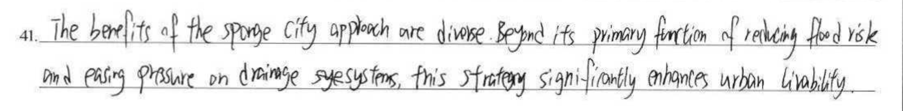
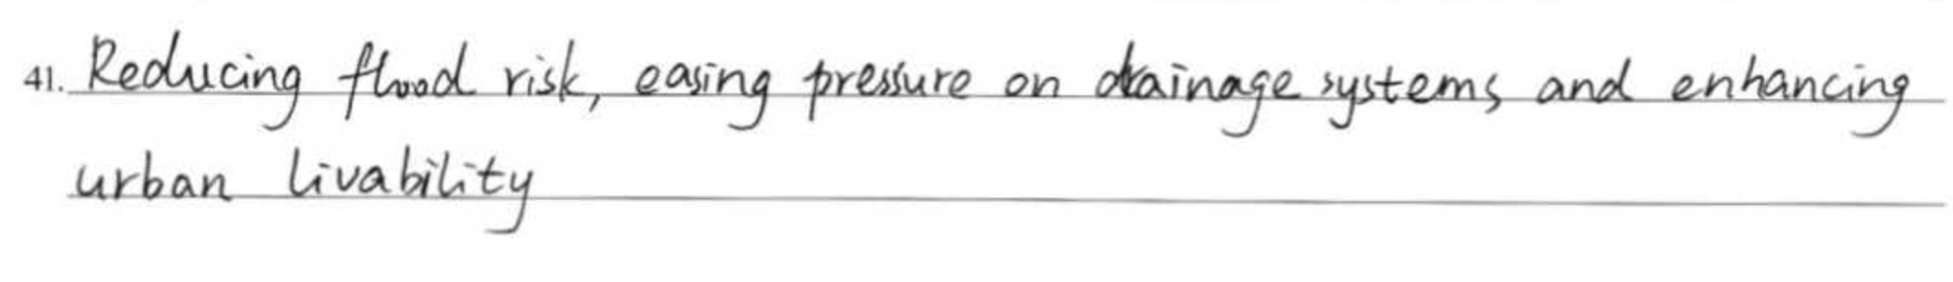
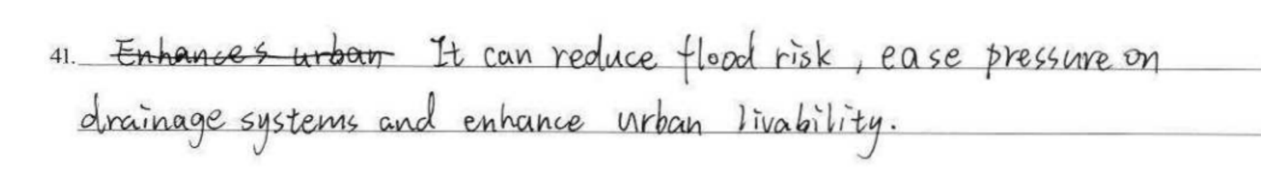

Slide 27
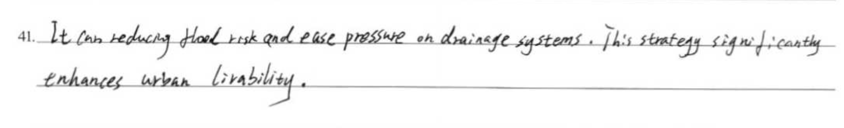
41. What are the benefits of the sponge city approach?
It reduces flood risk, eases pressure on drainage systems, and enhances urban livability.
重点说明：
1. Beyond its primary function of reducing flood risk and easing pressure on drainage systems, this strategy significantly enhances urban livability. How is this possible? It creates extensive green zones that expand healthy public spaces for recreation, improve air quality, and support increased urban biodiversity. (视为冗余，扣1分）
2.
扣0.5分: 动词错误

Slide 28
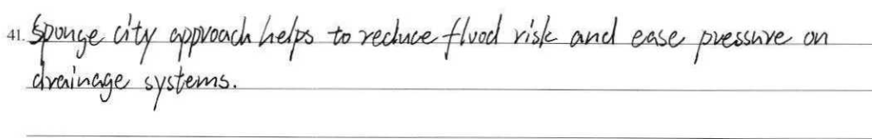
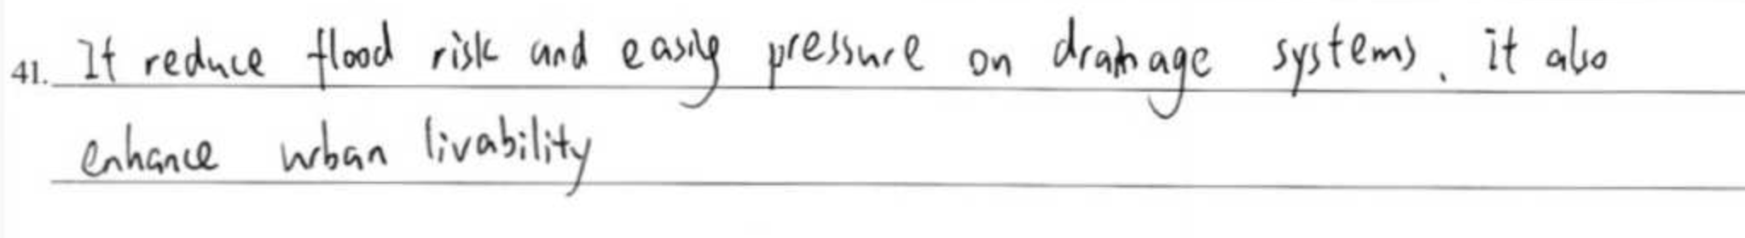
扣1分: 缺要点3
扣1分: 多处语言错误，累计最高扣1分

Slide 29
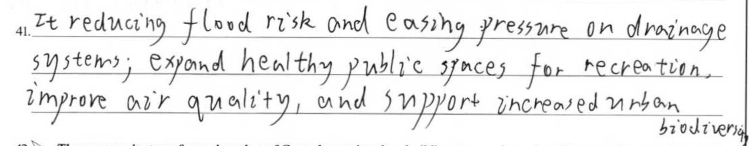
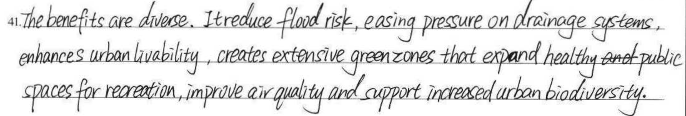
扣1.5分: 冗余+动词错误

Slide 30
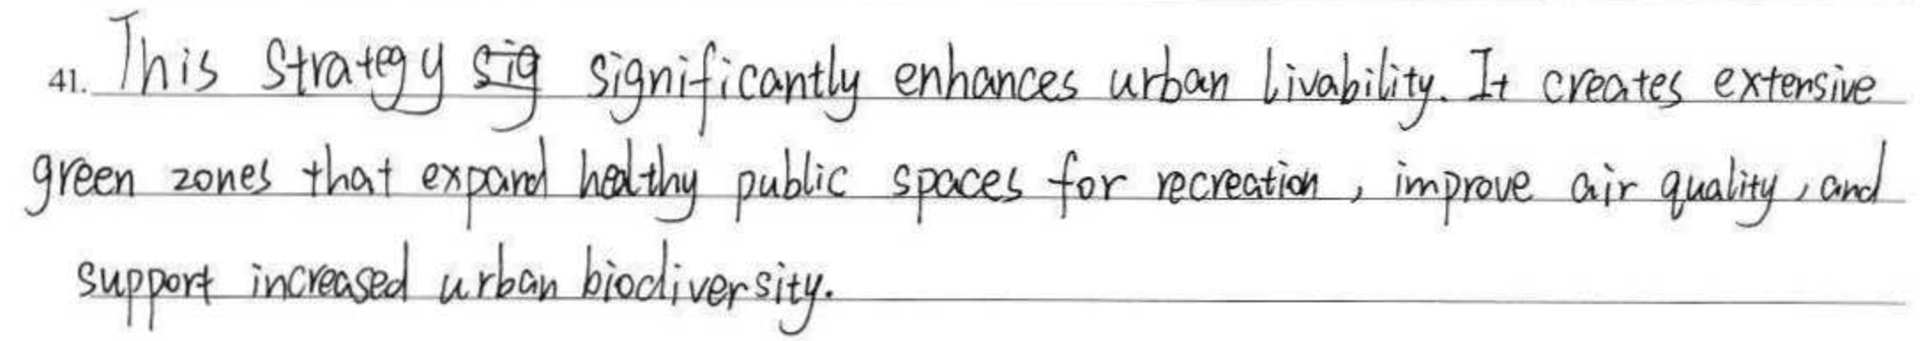
扣1.5分: 冗余+少要点1.2

Slide 31
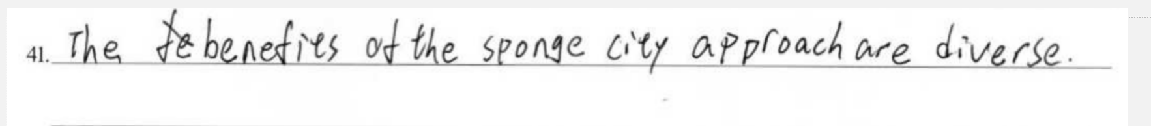
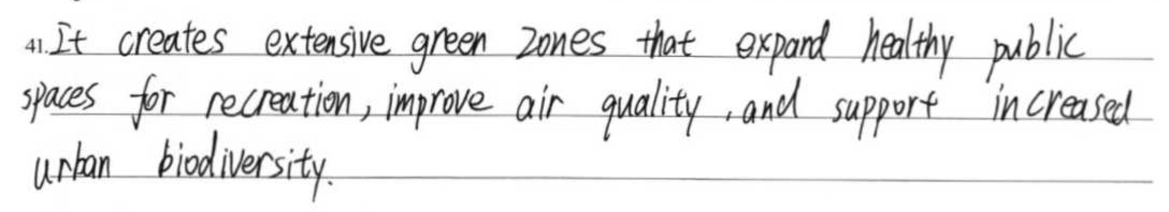
扣2分: 所答非所问

Slide 32
41题阅卷划重点：
1. 内容：前两个要点合起来占1分，第三点单占1分
2. 语言：动词和实词错误一处扣0.5，最高累计扣1分
3. 冗余：扣1分
ps. 冗余和语言错误可以累加

Slide 33
阅读表达42题参考答案

Slide 34
42题
划线和解释互不影响，阅卷老师先阅划线（1分），再阅解释（2分）。
0
0.5
1
1.5
2
0
1
划线部分分数设置
解释部分分数设置
Notes:
评分步长

Slide 35
42. Please decide which part is false in the following statement, then underline it and explain why.
The sponge city transformation plan of Copenhagen involves building new parks and making use of its canal network.
(Para. 4)... Following devastating floods of a 2011 storm, the city of Copenhagen launched its own sponge city transformation plan. Fundamental to the strategy are green infrastructure (基础设施) elements, such as redesigned parks that serve as retention basins during heavy rains, along with blue infrastructure like the city’s extensive canal network to channel and store excess water.
green （主） infrastructure
blue（次） infrastructure
redesigned parks
canal network

Slide 36
42. Please decide which part is false in the following statement, then underline it and explain why.
满分情况1
The sponge city transformation plan of Copenhagen involves building new parks and making use of its canal network.
满分情况2
The sponge city transformation plan of Copenhagen involves building new parks and making use of its canal network.
解释：and前后是两个并列的意群，前者和原文不符，后者和原文相符。没有错的后者划得零分，高考里的多划没有超越意群的。

Slide 37
42. Please decide which part is false in the following statement, then underline it and explain why.
The sponge city transformation plan of Copenhagen involves building new parks and making use of its canal network.
(Para. 4)... Following devastating floods of a 2011 storm, the city of Copenhagen launched its own sponge city transformation plan. Fundamental to the strategy are green infrastructure (基础设施) elements, such as redesigned parks that serve as retention basins during heavy rains, along with blue infrastructure like the city’s extensive canal network to channel and store excess water.
  According to the passage, the sponge city transformation plan of Copenhagen involves redesigning parks and making use of its canal network.
involve doing sth

Slide 38
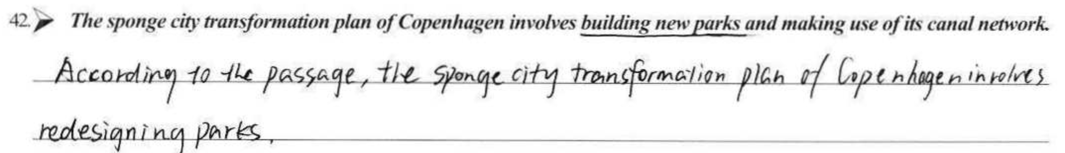
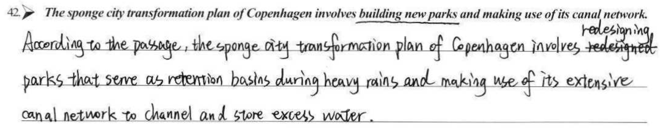

Slide 39
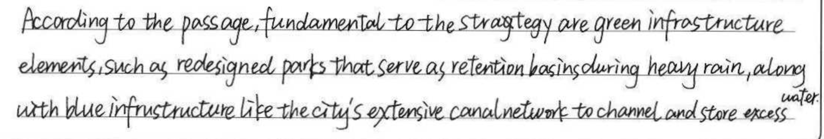
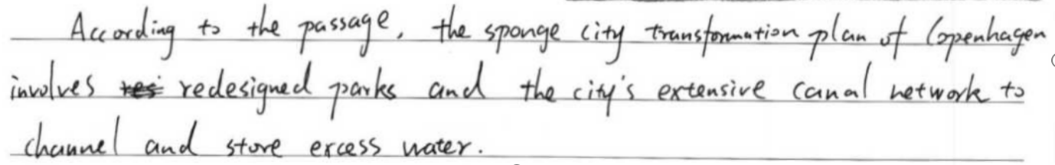

Slide 40
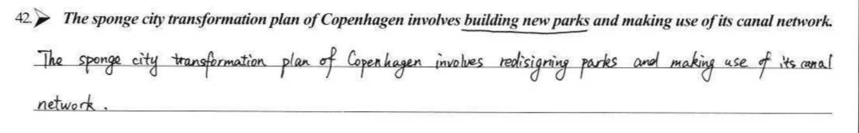
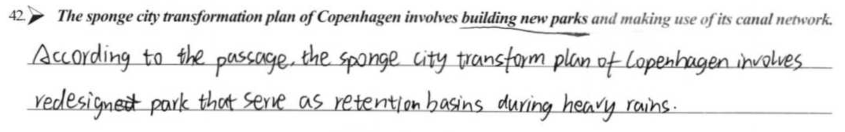
扣0.5分: 动词错误
involve doing sth
扣1分: 累计语言错误

Slide 41
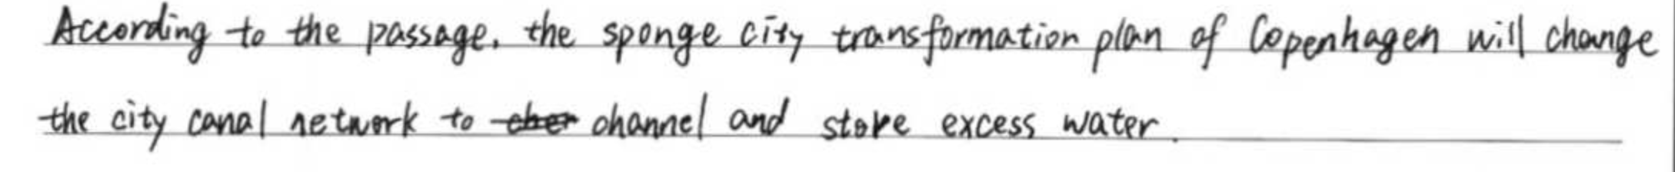
扣2分: 未针对错误内容进行有效修改

Slide 42
42题阅卷划重点：
1. 划线：只接受2种正确情况
2. 解释：准确修改错误之处，尤其注意语法错误
（动词和实词错误一处扣0.5，最高累计扣1分）

Slide 43
阅读表达43题评分标准

Slide 44
原则：先按照内容定档，再根据语言扣分，有0.5分档。
0
0.5
1
1.5
2
2.5
3
3.5
4
4.5
5

Slide 45
43. 评分三维度：内容；语言；词数
词数：数行不数词，按1行11词计，严格执行超过4行半扣0.5分，最好4行整（一模）
5分 | 紧扣主题 ，仅有个别语言错误
3-4分 | 贴近主题 ，有一些语言错误，但不影响理解
1-2分 | 与主题相关 ，大量语言错误，影响理解
0分 | 与主题不相关

Slide 46
43. In addition to what is mentioned in the passage,, what other way(s) would you propose to make your city more livable? (In about 40 words)
Para. 2 How do sponge cities work? These cities combine sustainable technologies and functional landscaping, including pavements that allow water to go down into the ground; urban parks and green spaces that act as places to hold water during heavy rain and as recreational zones during dry periods; urban wetlands that naturally filter water and promote biodiversity; waterways and channels that are linked together to efficiently transport and store water.
Para. 3 It creates extensive green zones that expand healthy public spaces for recreation, improve air quality, and support increased urban biodiversity.
Para. 4 Fundamental to the strategy are green infrastructure (基础设施) elements, such as redesigned parks that serve as retention basins during heavy rains, along with blue infrastructure like the city’s extensive canal network to channel and store excess water.

Slide 47
What is mentioned in the passage?
1. urban parks /redesigned parks /green spaces/extensive green zones/urban wetlands that act as places to hold water during heavy rain and as recreational zones during dry periods, expand healthy public spaces for recreation, improve air quality and promote biodiversity
2. waterways/canal network that are linked together to efficiently transport and store water；pavements that allow water to go down into the ground

Slide 48
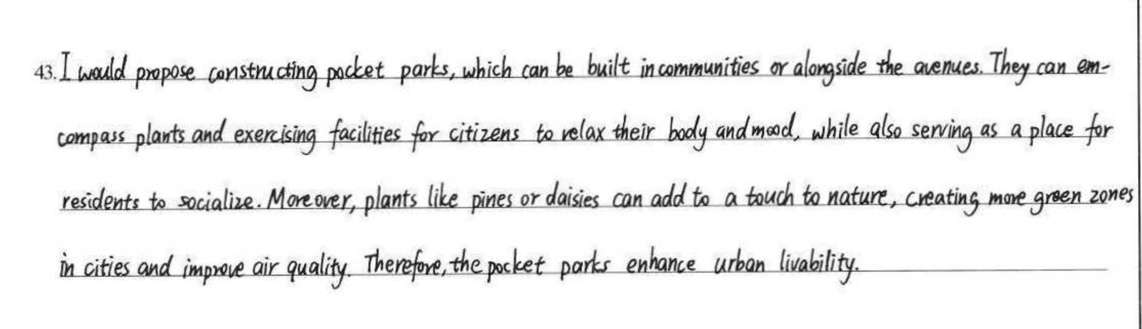
审题失误最高2分

Slide 49
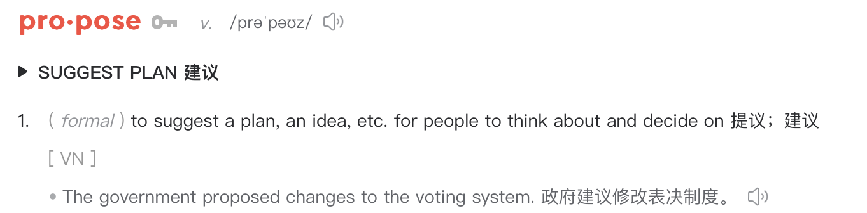
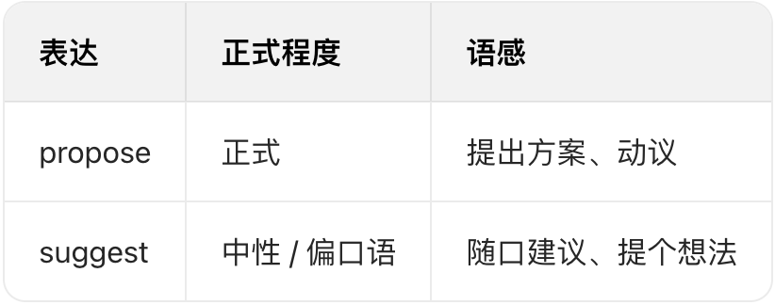
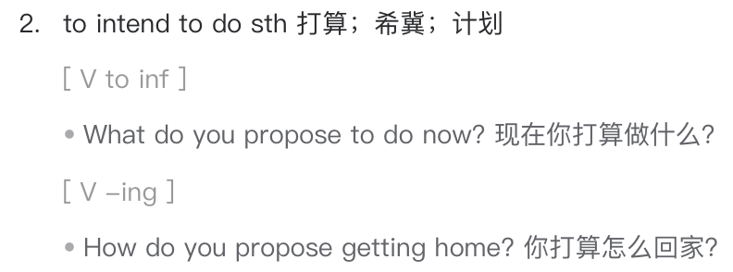
43. In addition to what is mentioned in the passage, what other way(s) would you propose to make your city more livable? (In about 40 words)
基于生活观察-发现问题-解决问题

Slide 50
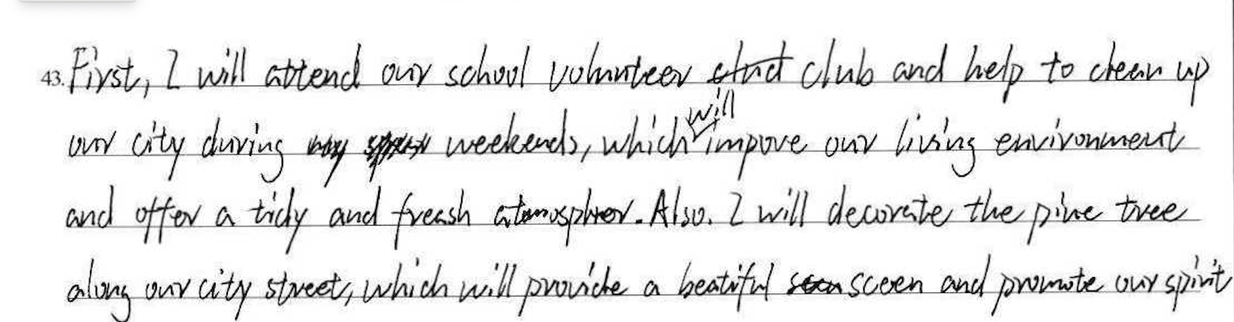
2分 审题有问题

Slide 51
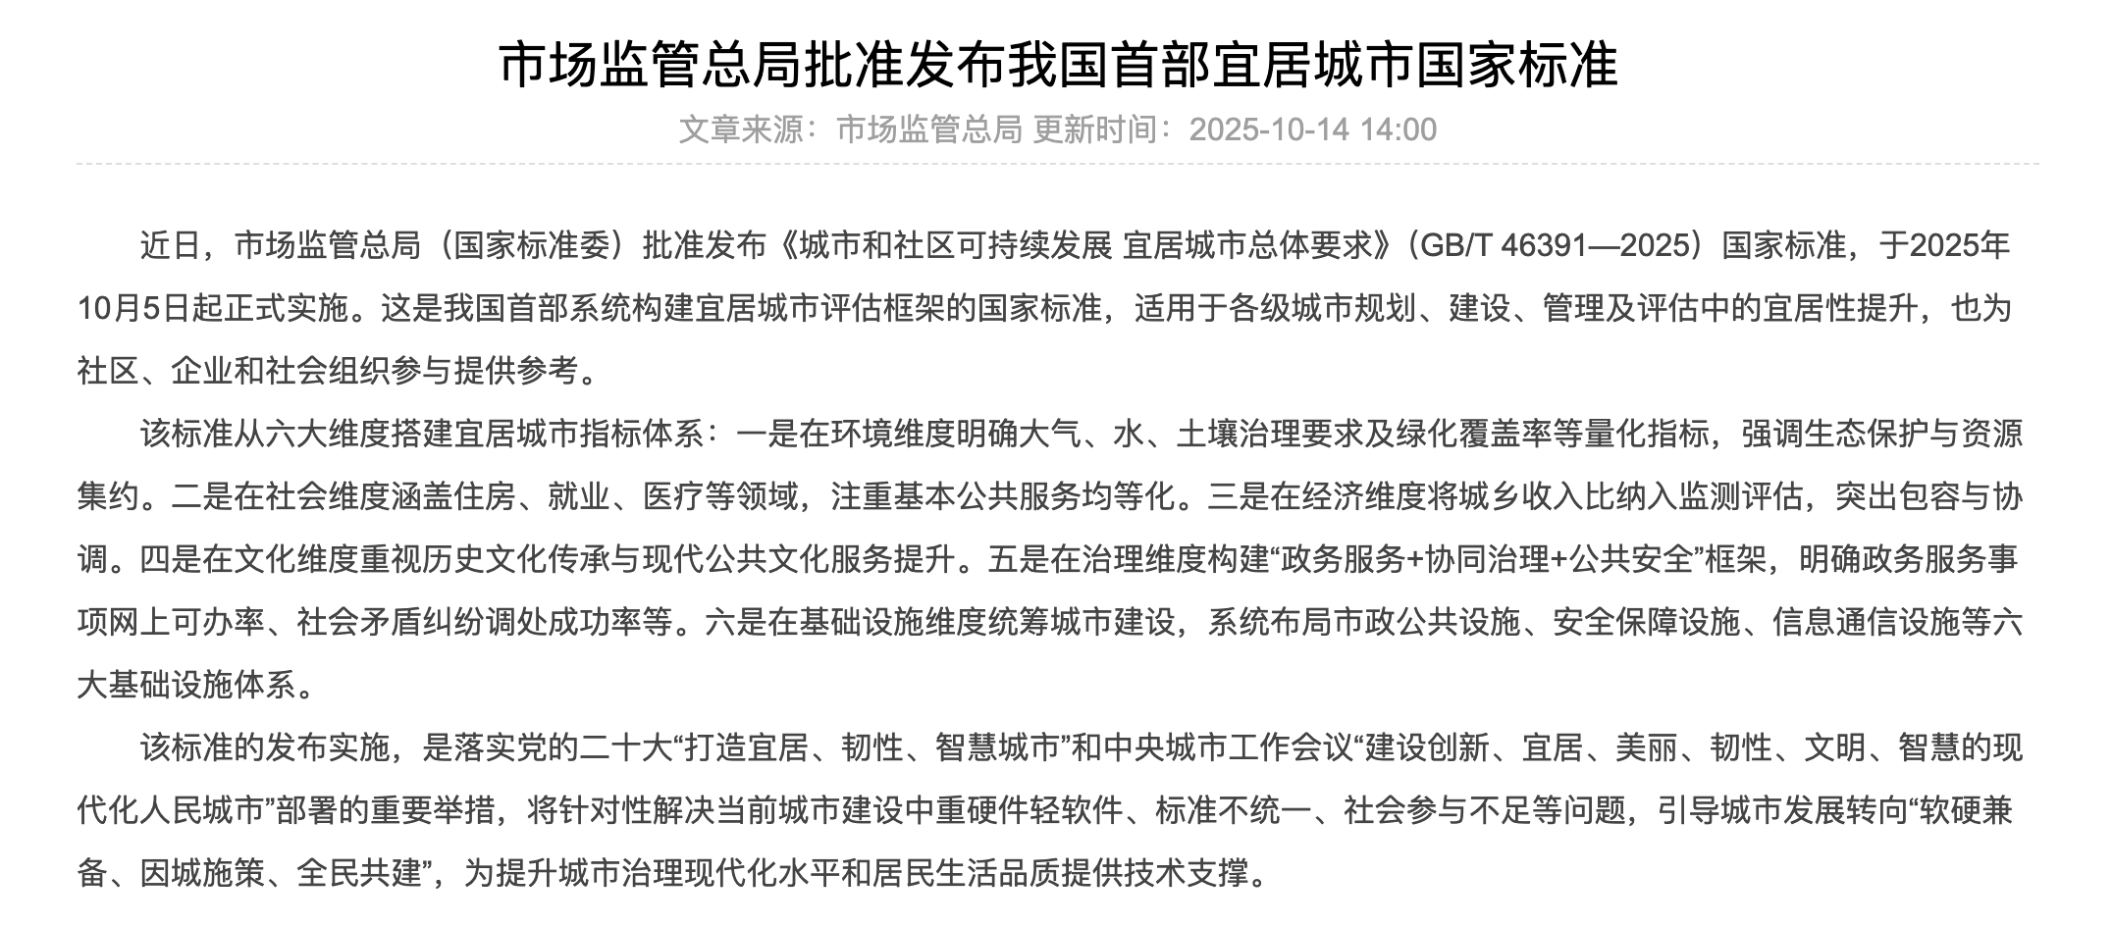
参考维度1

Slide 52
参考维度1
1 | Environment | Expand protected bike lanes and pedestrian-only zones in central Beijing
2 | Society | Allocate more affordable housing for people in need, and expand community-based medical and childcare services
3 | Economy | Relocate high-quality urban industries to suburban districts and develop rural cultural tourism and digital agriculture.
4 | Culture | Create a “Beijing Urban Running Heritage Route” that passes through historic areas such as the Temple of Heaven, Qianmen, and nearby hutongs, with regular guided runs and community running events.
5 | Governance | Expand the “12345” hotline to a community-level responsive platform and fully digitize government services for 100% online accessibility.
6 | Infrastructure | Build a city-wide network of 5G base stations and EV charging points

Slide 53
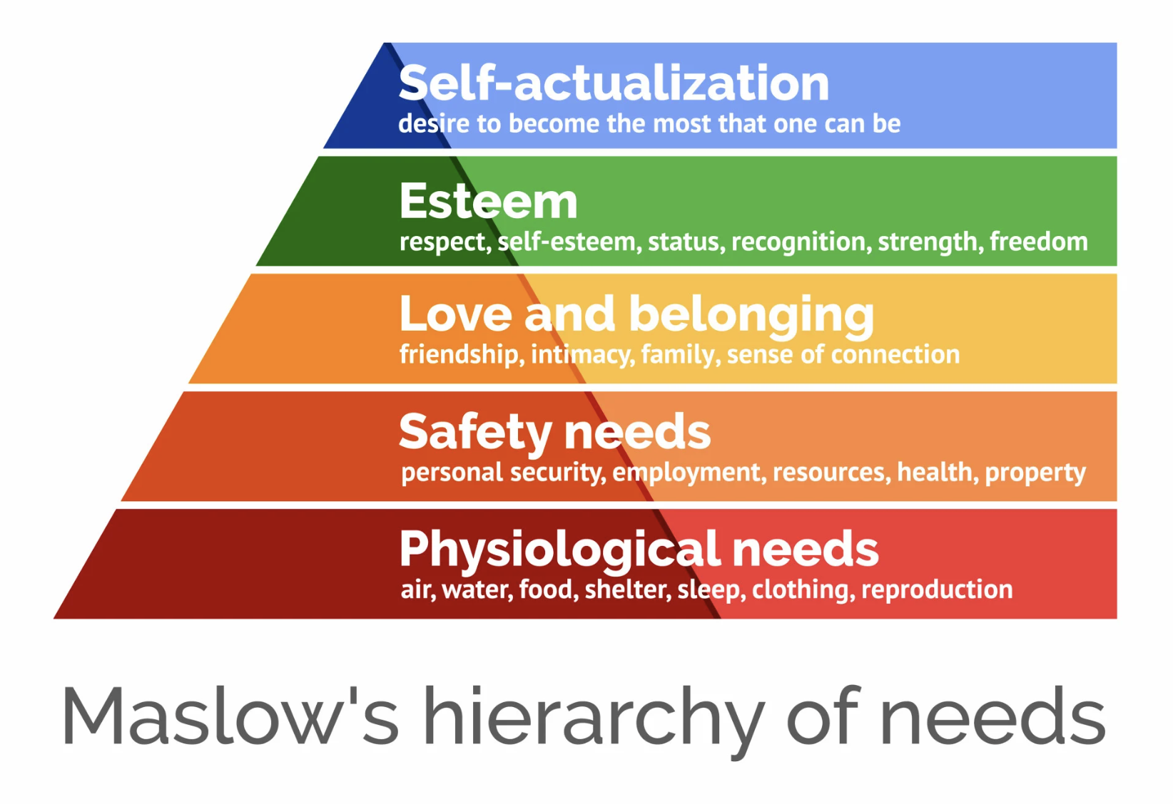
参考维度2
https://www.simplypsychology.org/maslow.html

Slide 54


参考维度2
1. Foundation
Air Quality
Propose: Accelerate the transition to electric vehicles (EVs) with better incentives and infrastructure (more charging stations) to reduce air pollution.
Affordable Housing
Propose: Increase the supply of affordable housing (public rental housing, shared-ownership housing) to reduce the burden on low- and middle-income families.

Slide 55
参考维度2
2. Safety Needs
Personal Safety
Propose: design more pedestrian-only zones and protected bike lanes to reduce traffic accidents; build more smart monitoring systems to enhance fire safety and emergency response.
Employment Safety
Propose: offer free or subsidized training programs in growing sectors like green technology, AI, healthcare, and senior care.
Health Security
Propose: Decentralize healthcare resources by building more high-quality clinics and hospitals in suburban and new urban areas to reduce overcrowding in central facilities.

Slide 56
参考维度2
3. Love and Belonging
sense of connection
Propose:
(1) Organize community-led events, like neighborhood festivals, book exchanges, sports events to build a sense of local identity and connection.
(2) create more third places—public spaces that are not home (1st) or work (2nd). Invest in libraries, community centers and parks with seating and amenities where people can gather and interact for free. Ensure those public spaces are fully accessible for the elderly and people with disabilities.

Slide 57
Possible Version 1 (一个点：infrastructure + 两个原因）
I would propose creating more pedestrian-only zones and protected bike lanes, which are beneficial for improving air quality by reducing traffic congestion. In addition, local residents would be encouraged to choose walking and cycling, thereby lowering the risk of traffic accidents and promoting better public health. （46 words）
Possible Version 2 (2个点：society & culture + 各自解释）
First, I would propose expanding affordable housing, such as shared-ownership housing, to reduce financial pressure on low- and middle-income families. It would also be wise to create a “Beijing Urban Running Heritage Route” that passes through historic areas, encouraging regular exercise and deeper cultural engagement among residents. (49 words)

Slide 58
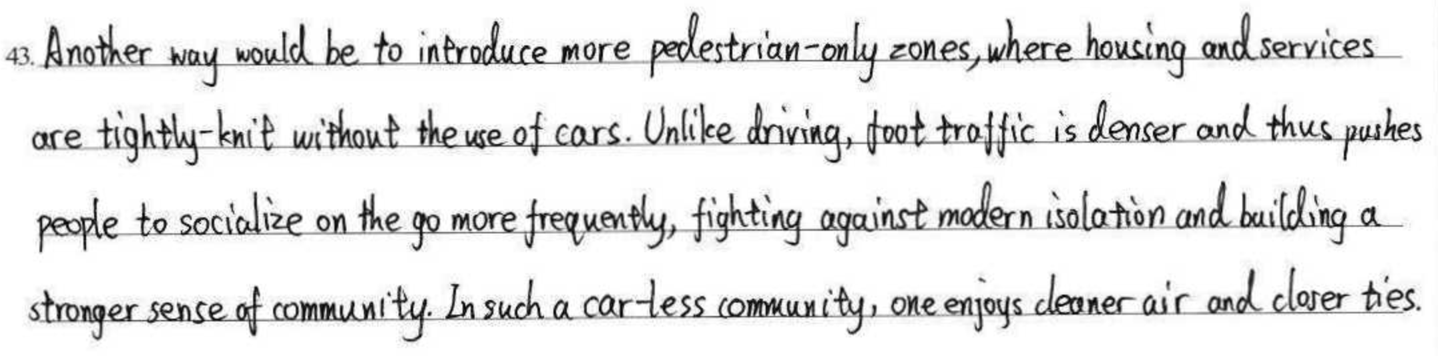
1要点+2个原因
5分： 紧扣主题，语言精准，结构清晰。

Slide 59
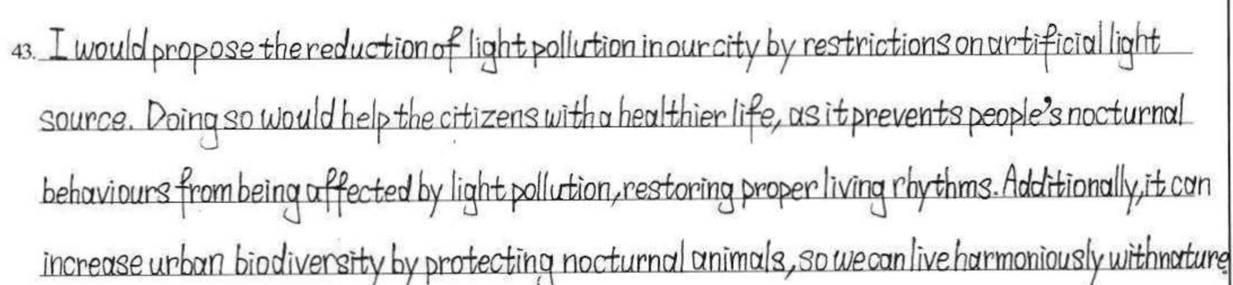

y
1要点+2个原因
5分： 紧扣主题，语言精准，结构清晰。微有瑕疵：字间间隔可以稍微大点。

Slide 60

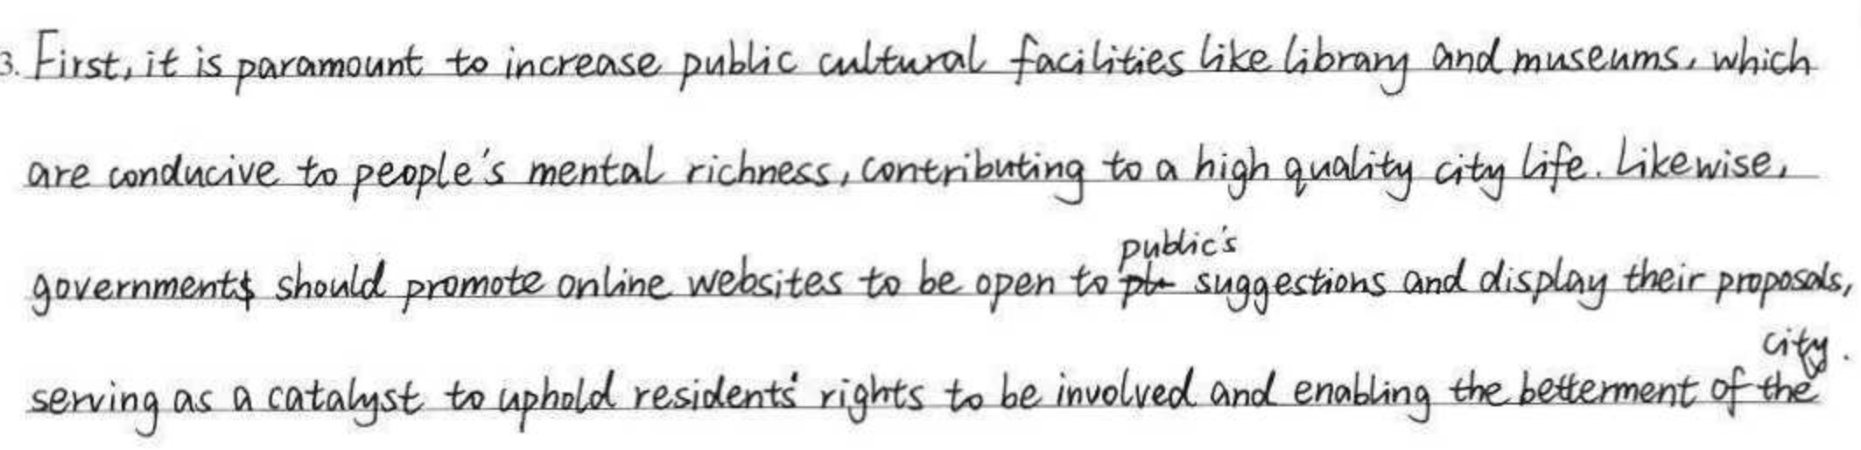
两要点+各自解释
5分： 紧扣主题，语言精准，结构清晰。

Slide 61
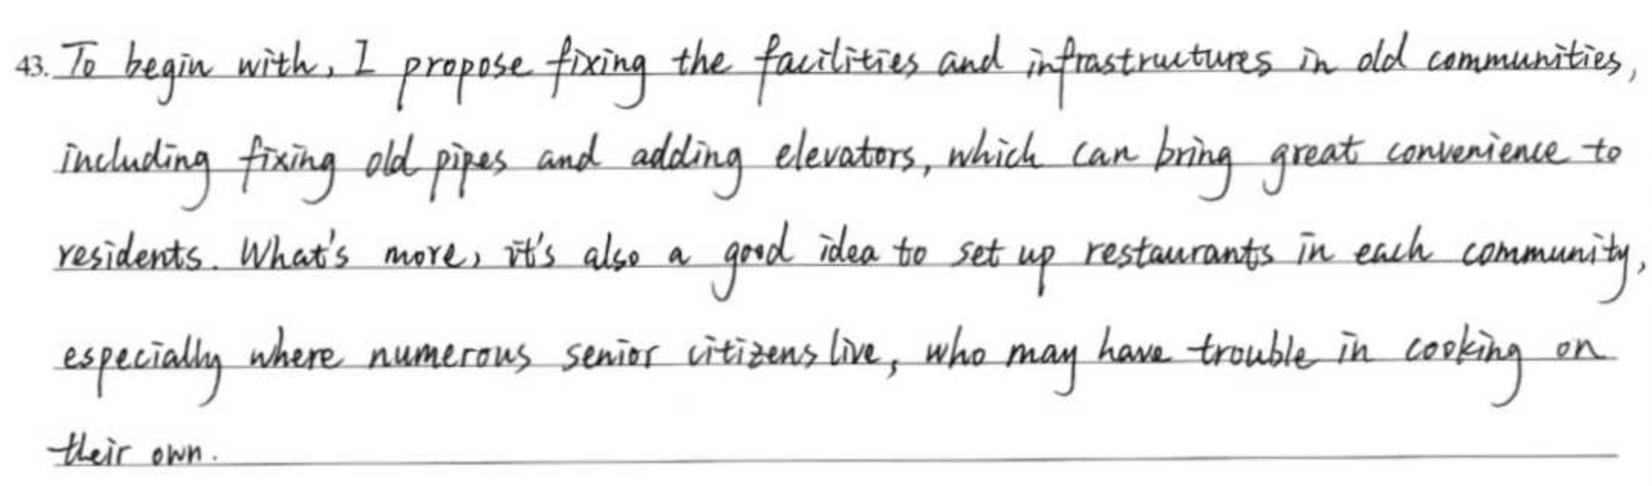
两要点+各自解释
4.5分 紧扣主题，结构清晰，infrastructure为不可数名词，restaurants最好改为canteens

Slide 62

1要点+2个原因
，，
4.5分 紧扣主题，具有创新性，逻辑清晰，语言质量高，个别地方（如bonds）影响理解

Slide 63

4分：一个点+两个原因，论据充分，但逻辑需显性化：在第二个原因前加a linking word。

Slide 64

3.5分 内容较好，逻辑清晰，但多处语言错误。

Slide 65

3.5分 原本可4分，超4.5行，扣0.5分。

Slide 66

3分 多处重大语言错误。

Slide 67

2.5分，语言质量较好，但第一个点无效

Slide 68
2分 审题有问题

Slide 69

1.5分 逻辑不通，多处语言错误，影响理解。

Slide 70

1分 跑题+多处语法错误

Slide 71
43题阅卷重点：
1. 先定档，再根据语言扣分。
2. 跑题最高2分。
3. 严控字数行数，超4.5扣0.5分。

Slide 72
04
复习建议

Slide 73
1. 关注答题语言的规范性、准确性和完整性。
阅读表达题40-42题需要考生认真审题，保证所答即所问，注重人称、时态、拼写等无误。
2. 训练43题审题和选材。
开放问题需在审题正确的基础上确定选材，选材切忌空泛。平时学习时可通过专题学习和作文范文积极积累语料。

